Slide 1
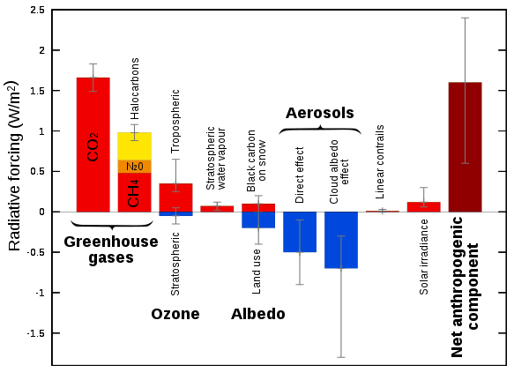
Recap: anthropogenic radiative forcings
I want to flesh out for you where these gases/aerosols occur in the context of the vertical and horizontal structure of the atmosphere.

Slide 2
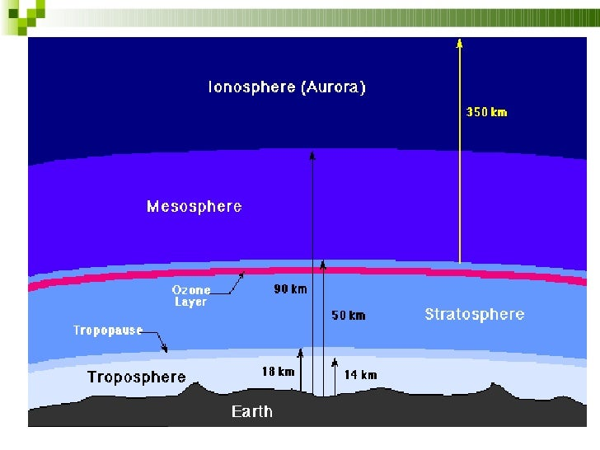
Vertical (we looked at this before): the troposphere+stratosphere
Together, the Troposphere and Stratosphere contain most (95%) of the air!
However, their thickness spans less than 1% of Earth’s radius (~6000 km) – like the skin of an apple.
For comparison, Seattle is all of 50 km from Tacoma (horizontally).
Tacoma
Seattle

Slide 3
Vertical (we looked at this before): the troposphere+stratosphere
Together, the Troposphere and Stratosphere contain most (95%) of the air!
However, their thickness spans less than 1% of Earth’s radius (~6000 km) – like the skin of an apple.
For comparison, Seattle is all of 50 km from Tacoma (horizontally).
Tacoma
Seattle
Earth’s surface

Slide 4
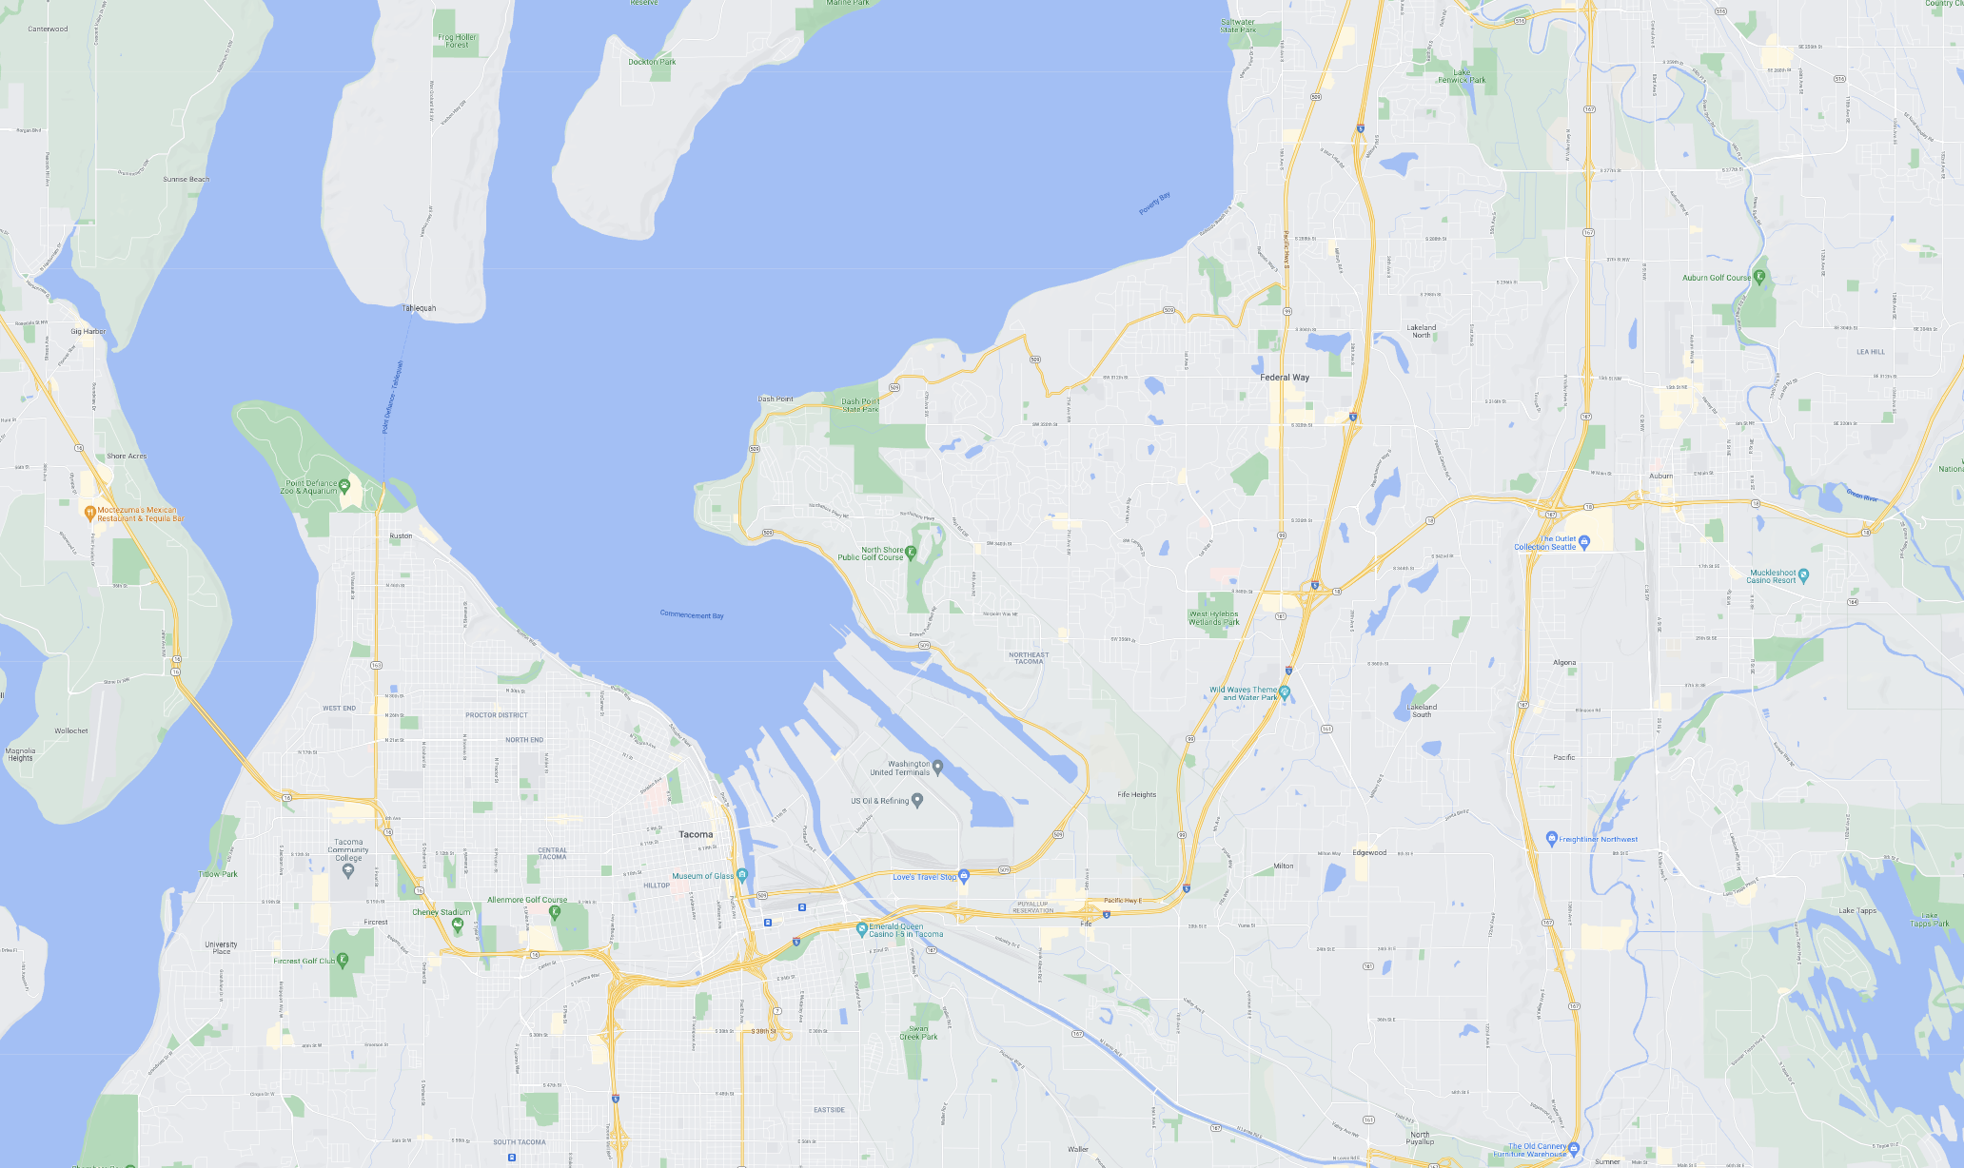
The troposphere alone contains 75% of the atmosphere’s mass!
The vertical distance from the surface to the top of the troposphere is about the same as the horizontal distance from UPS to Federal Way.

Slide 5
Vertical (we looked at this before): the troposphere+stratosphere
Together, the Troposphere and Stratosphere contain most (95%) of the air!
However, their thickness spans less than 1% of Earth’s radius (~6000 km) – like the skin of an apple.
For comparison, Seattle is all of 50 km from Tacoma (horizontally).
Tacoma
Fed. Way
Earth’s surface

Slide 6
Vertical (we looked at this before): the troposphere+stratosphere
Together, the Troposphere and Stratosphere contain most (95%) of the air!
However, their thickness spans less than 1% of Earth’s radius (~6000 km) – like the skin of an apple.
For comparison, Seattle is all of 50 km from Tacoma (horizontally).
Tacoma
Fed. Way
Earth’s surface

Slide 7
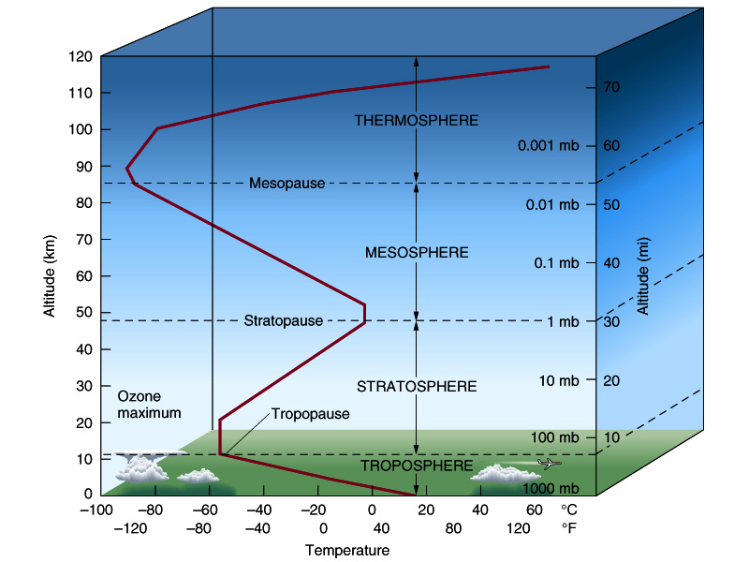

Here’s a depiction with the vertical distances in correct proportion to one another
If you go up in a balloon …
You’d notice the pressure going steadily down. For each 10 miles, pressure drops a factor of 10!
You’d also notice the temperature changing weirdly:
at first, temperature goes down (Troposphere)
then it starts to go up (Stratosphere)
then down and up again
The troposphere is where most of the weather and climate takes place.
The thickness of the atmosphere compared is like the skin of an apple.

Slide 8
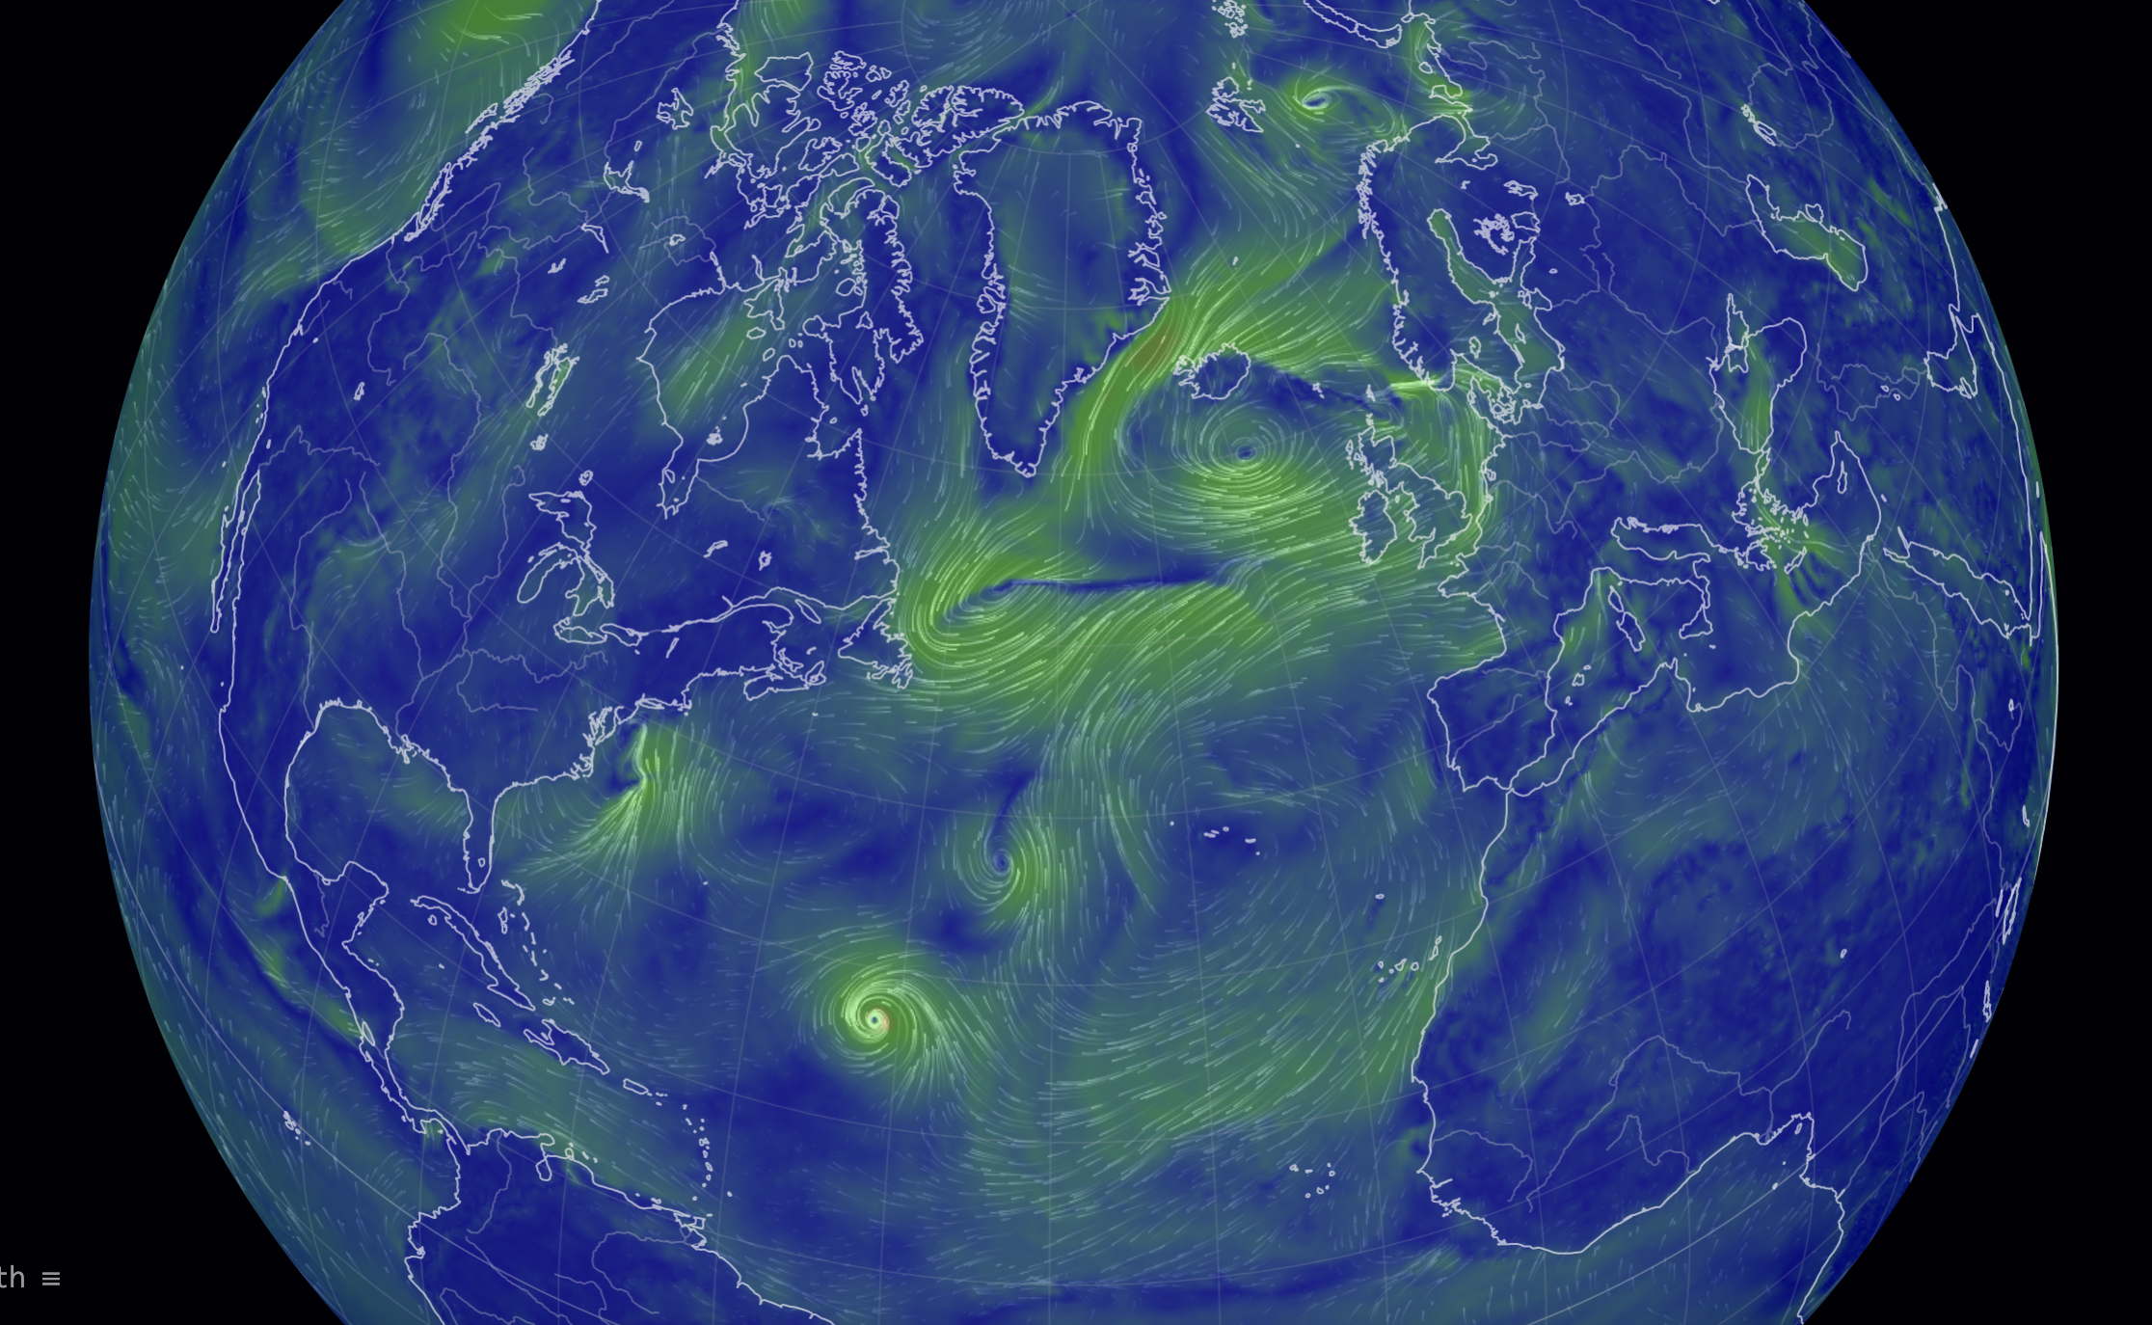
Horizontal structure: We’ve seen synoptic systems – some of which are semi-permanent
Famous semipermanent Lows:
Aleutians
Iceland
Off the coast of Antarctica
Famous Semipermanent Highs:
Hawaii
Bermuda
South Atlantic (between South America and Africa)
Indian Ocean (between Australia and Africa)
Off the coast of Southern California
Off the coast of Central Chile
Link

Slide 9
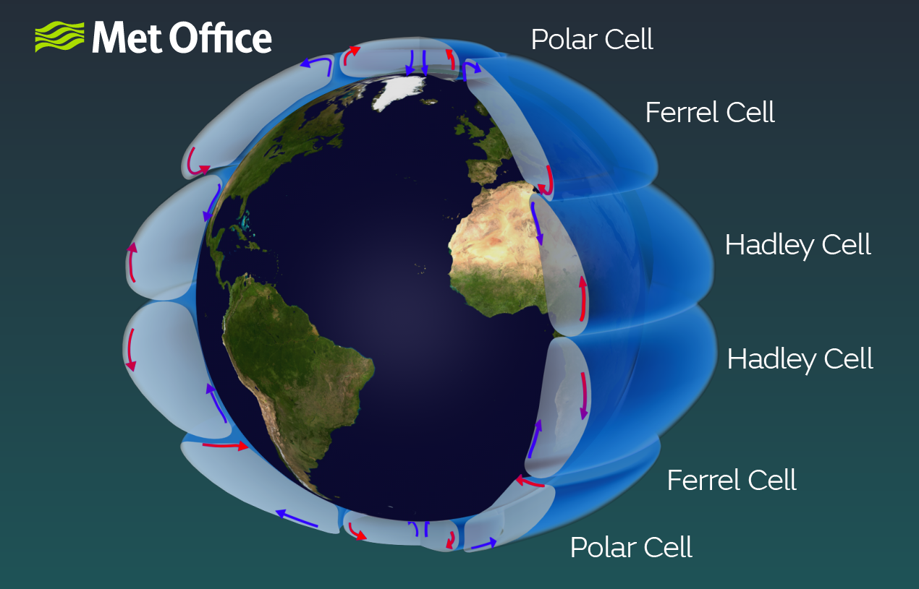
Horizontal structure: Polar, Ferrel, and Hadley cells
The vertical structure shown here is highly exaggerated

Slide 10
Horizontal structure: Polar, Ferrel, and Hadley cells
Uplift zones
Rising air tends to make cloudy skies, storms, and wet climates.
Subsidence zones
Descending air tends to make clear skies and dry climates.

